Slide 1

How can I access Carbon Credits (ACCUs)?
Can I use my existing plantation to generate Carbon Credits?

Slide 2
Carbon Project Options
Establishing New Plantations
Schedule 1: projects establish new plantations on non-forested sites where no plantation has existed for the previous 7 years.
Managing existing plantations:
Schedule 2: Changing from a short rotation to a long rotation (thin and grow on or clear-fall and replant).
Schedule 3: Continuing plantation forestry where it was intended to convert to a non-forest use (thin and grow on or clear-fall and replant).
Schedule 4: Transition to permanent forest where the land would have otherwise been converted to a non-forest use. No silviculture for 25 years (Thinning and growing on. A by-product of plantation thinning is improved plantation health).
All plantation carbon projects have a 25-year permanence period (project life) during which carbon must be sequestered and stored.

Slide 3
How do I participate in the CFI ACCU Scheme?
AKS Forest Solutions Pty Ltd provides forest management and brokering services to landowners, along with a one-stop shop for accessing carbon credits.
Our forestry solutions are tailor made. Our goal is to assist with the establishment of plantations and add value through ACCUs issued by the Clean Energy Regulator (CER).
Credits may be kept as offsets or sold in the open market. ACCUs may be treated as “shares” and held over to manage risk and cash flow, or assist in farm succession planning etc.
Under the AKS carbon project model, Landowners own the trees and the ‘lions share’ of carbon credits.

Slide 4
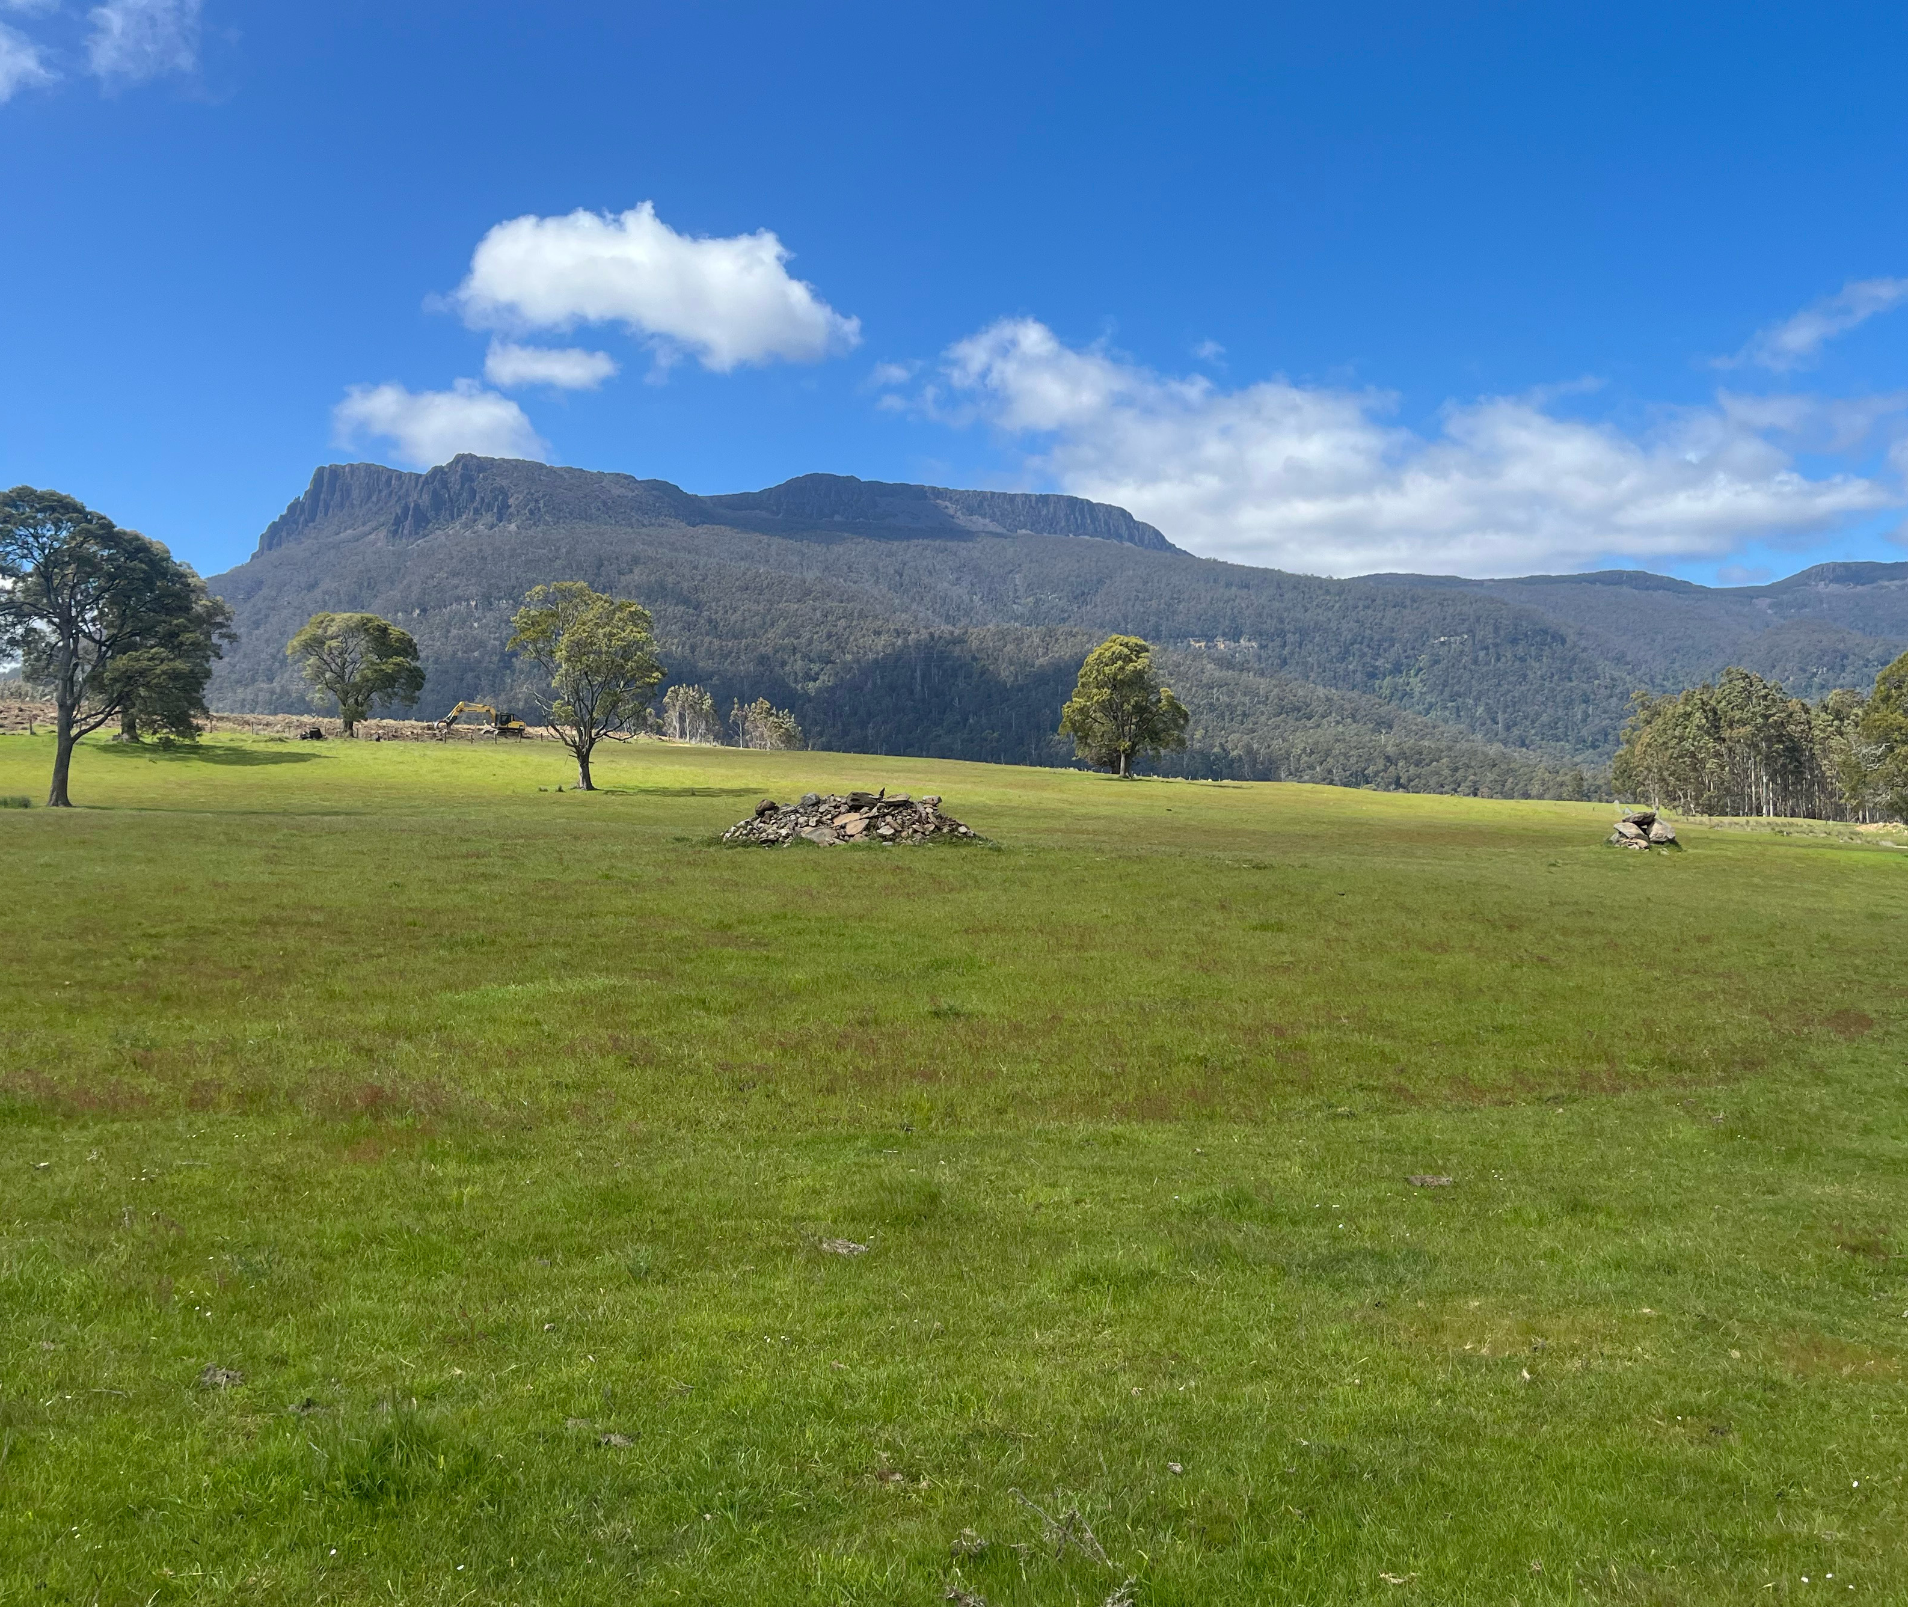
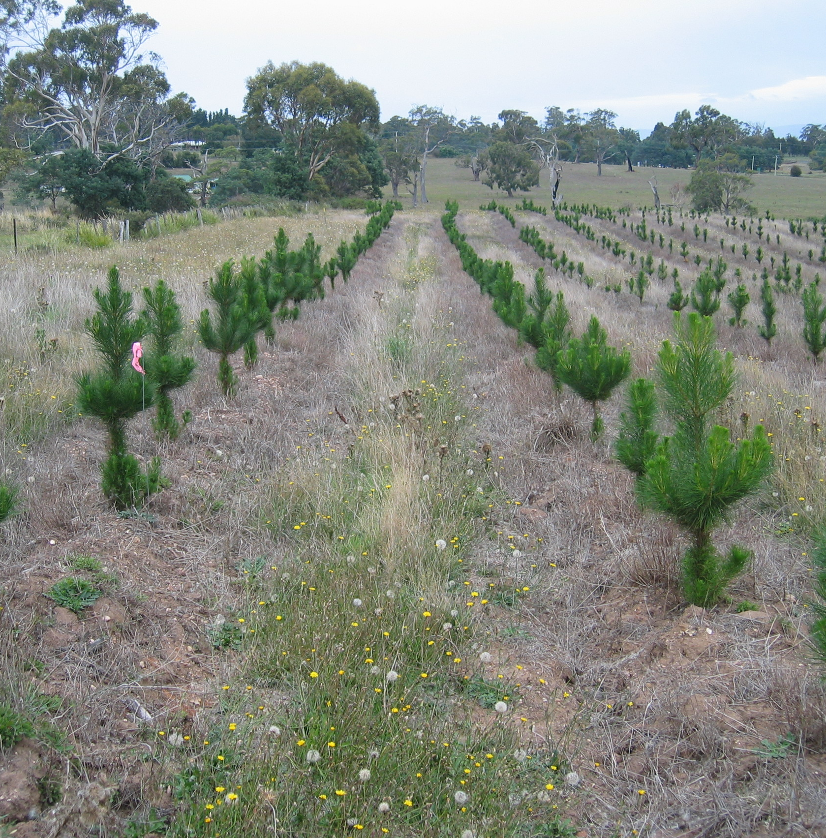
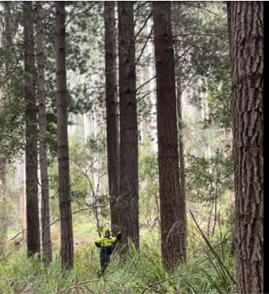
Schedule 1: Establish plantations on cleared land. (land which has not had woody vegetation for at least 7 years)

Slide 5
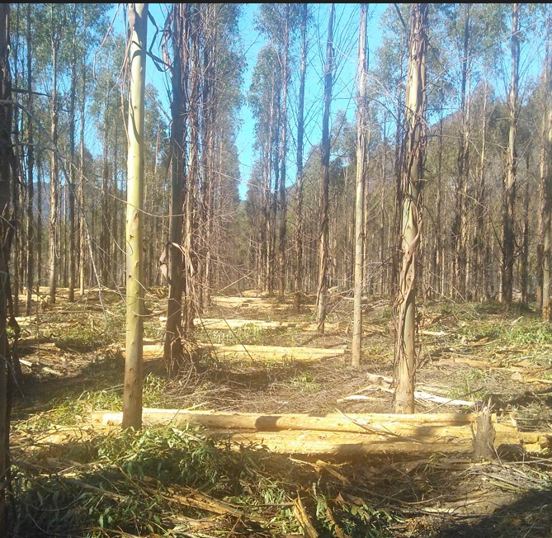
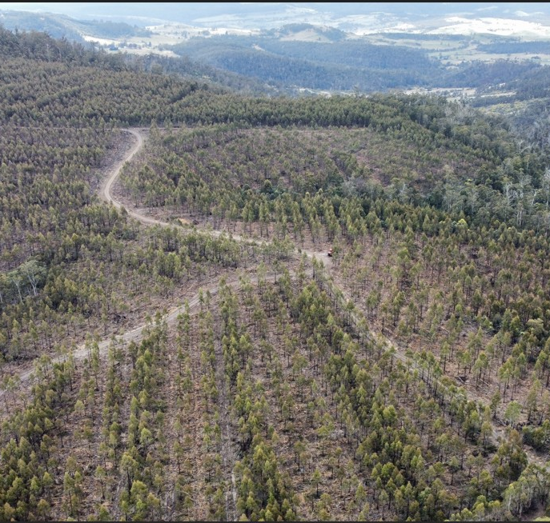
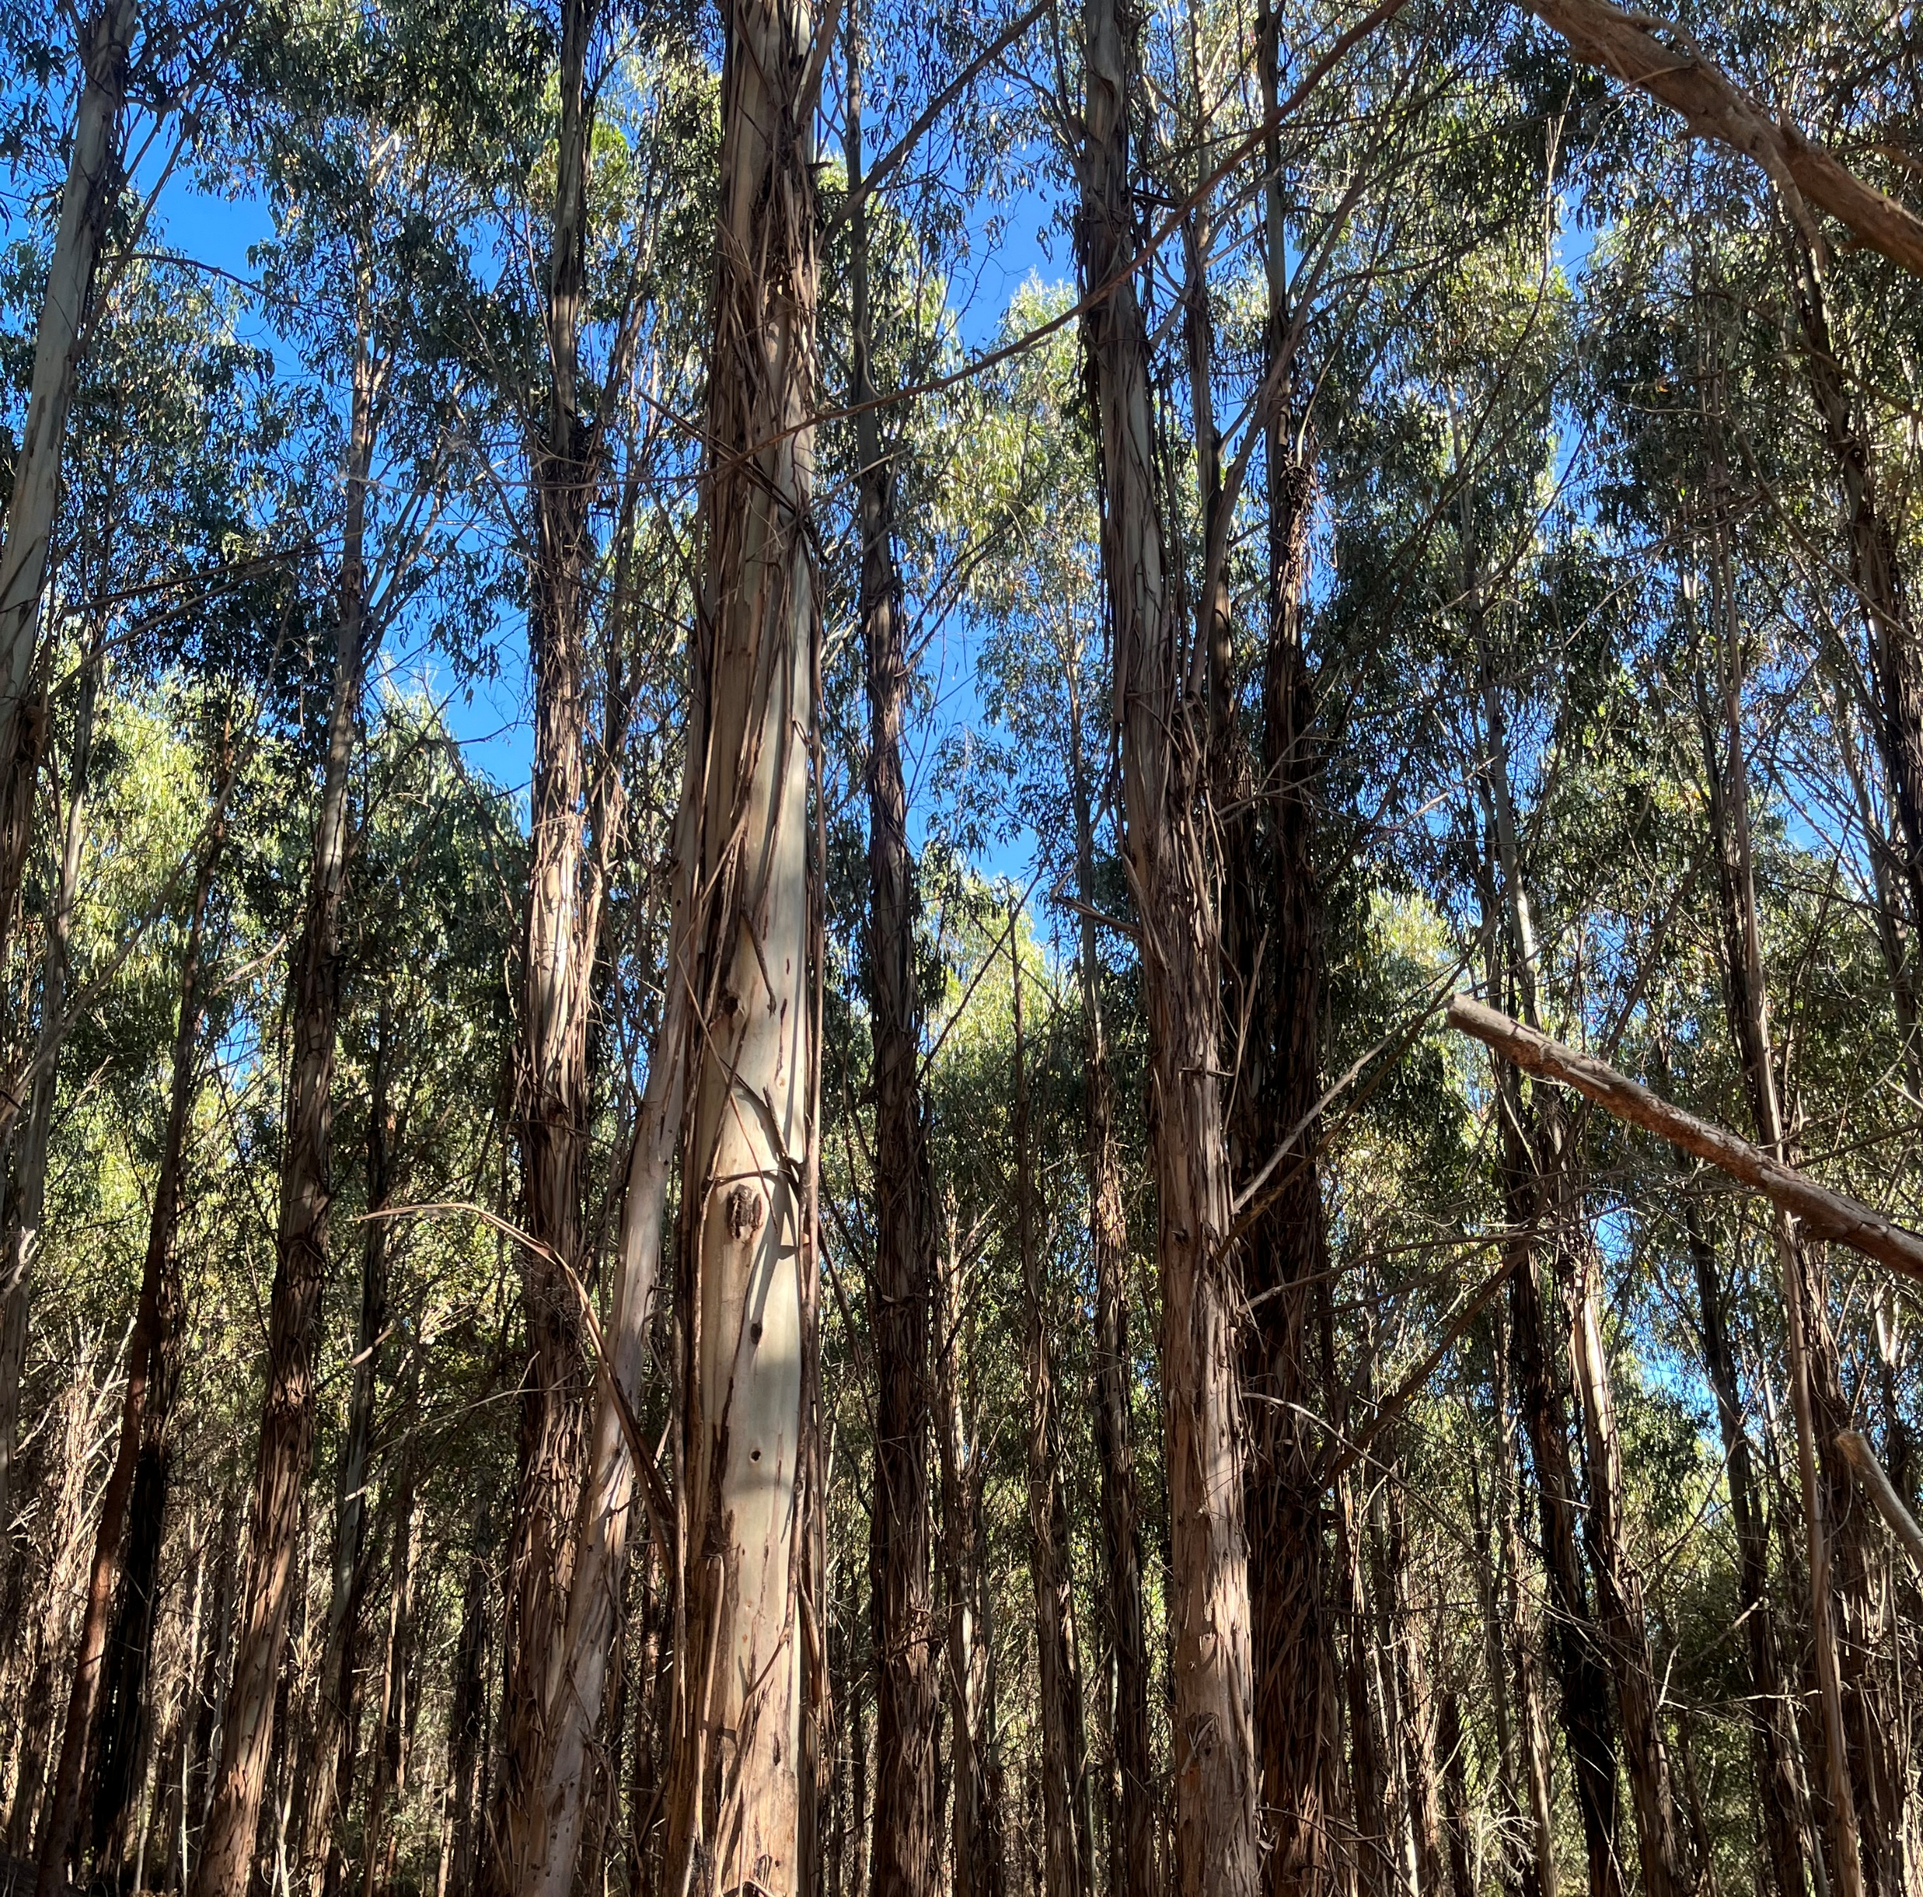
Schedule 3: Thin a plantation and grow it on. The age of the plantation is important.

Slide 6
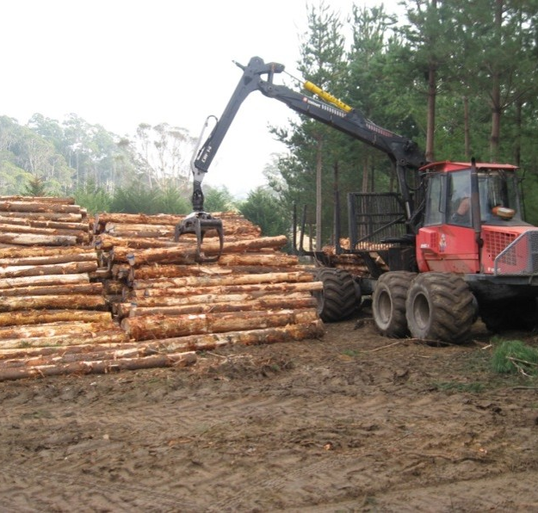
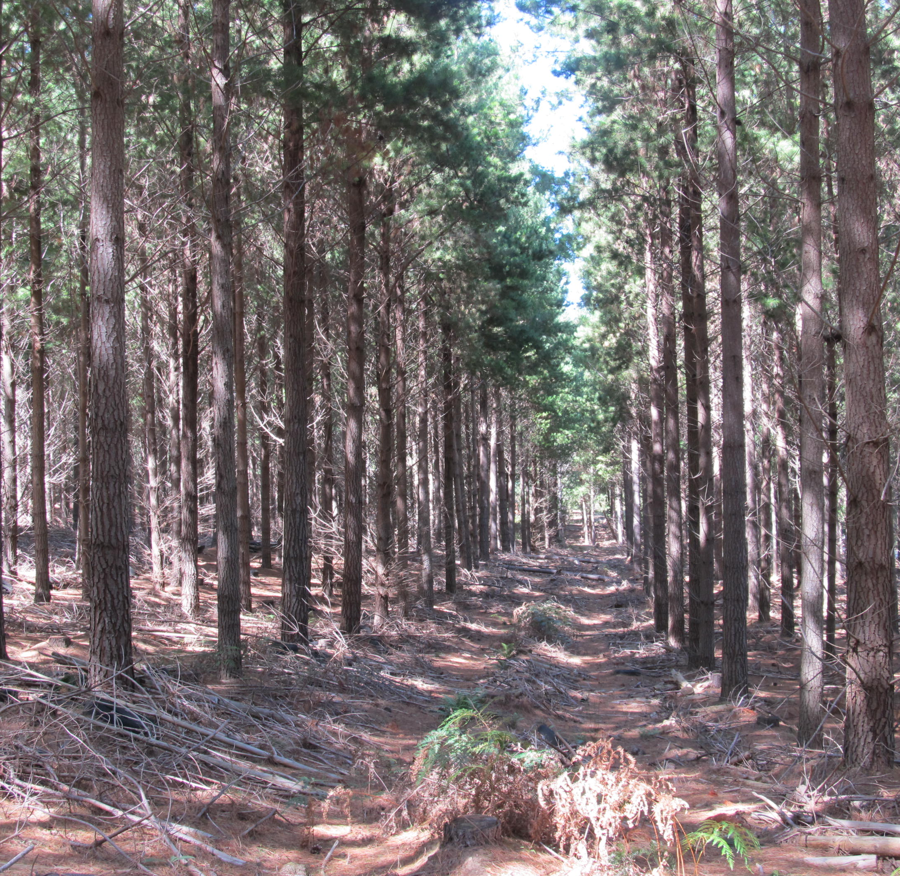
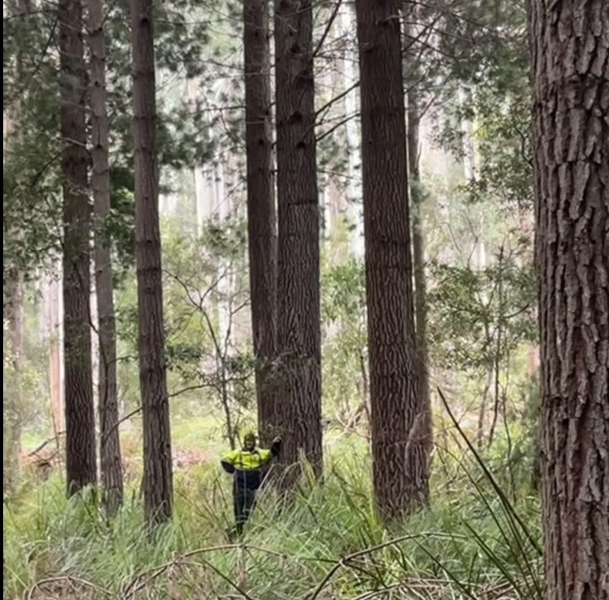
Schedule 3: Radiata pine plantations usually generate more ACCUs per ha than eucalypt plantations

Slide 7
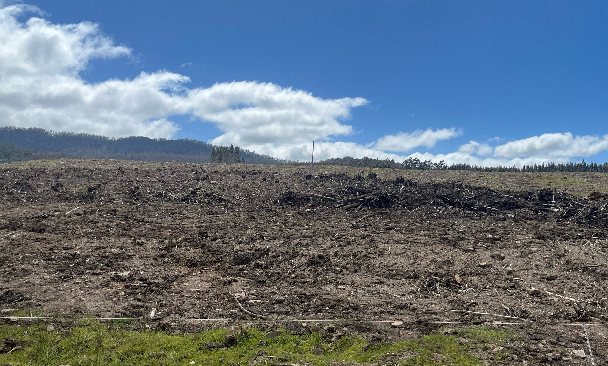
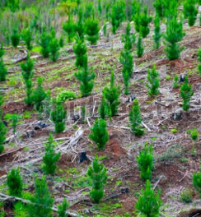
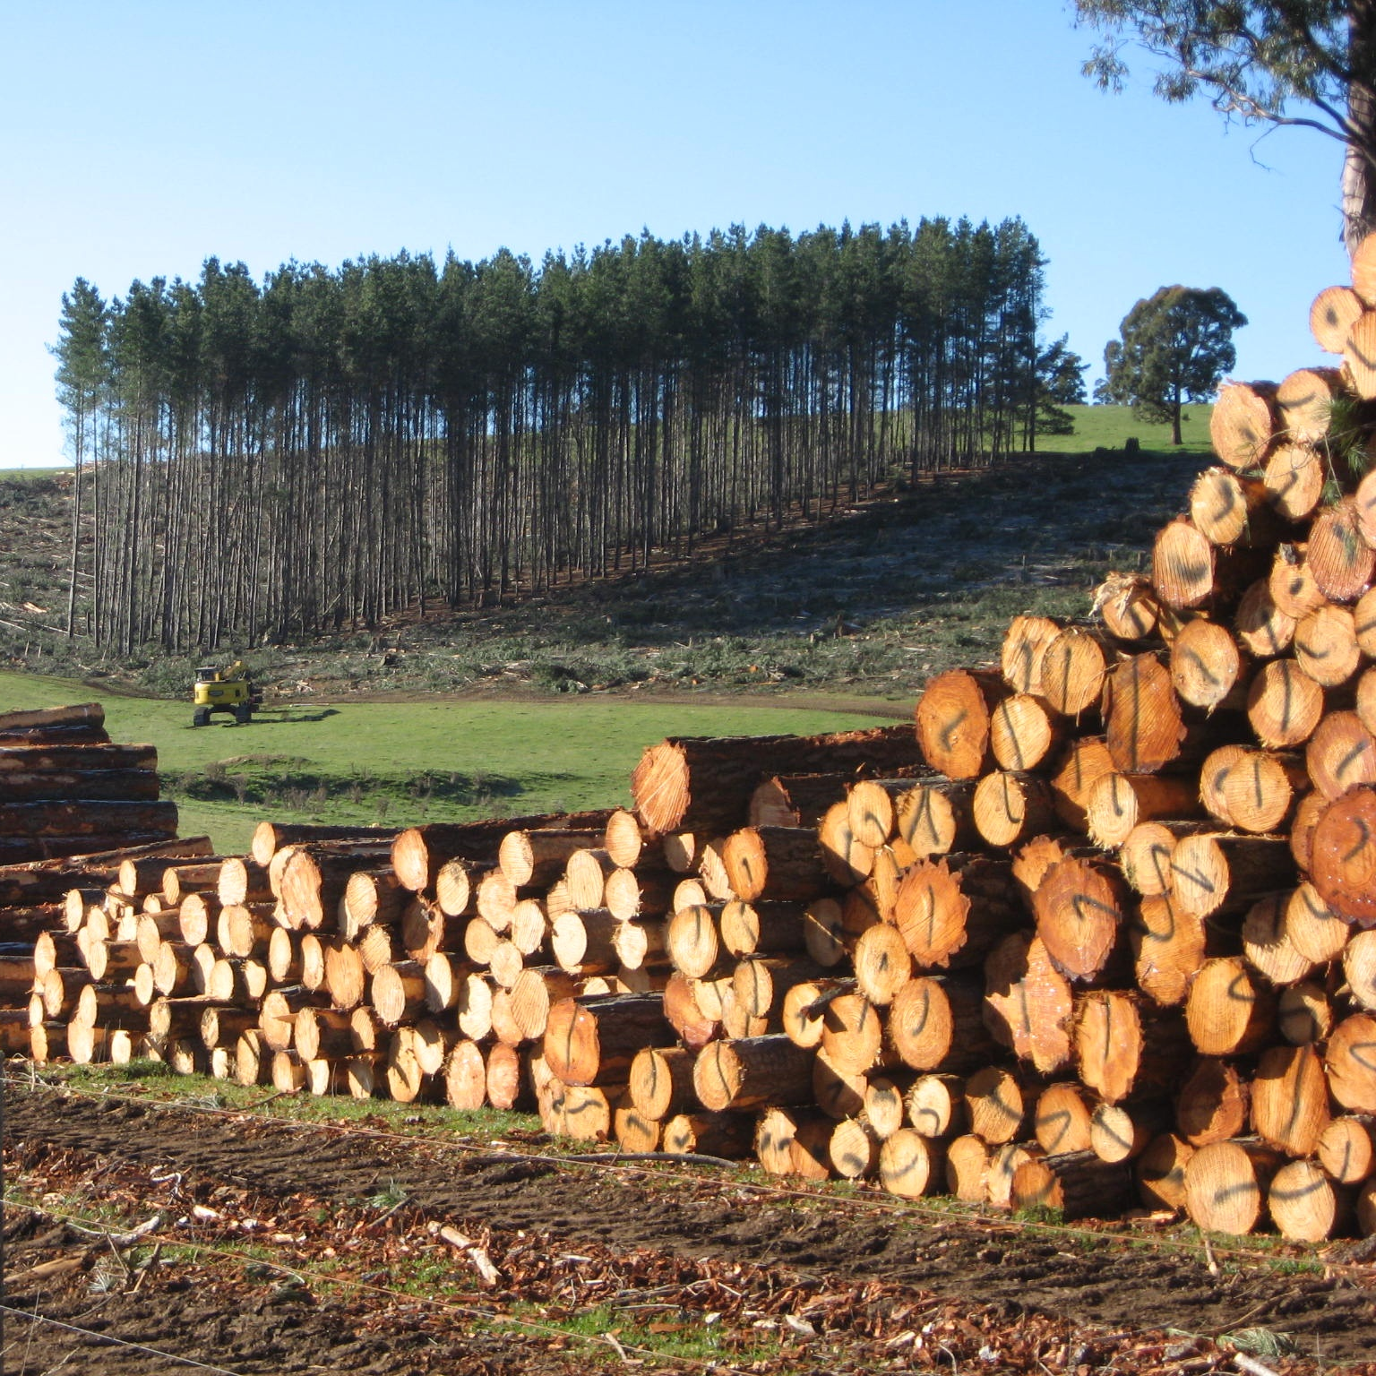
Schedule 3: Clear-fall a mature plantation and replant the site.

Slide 8
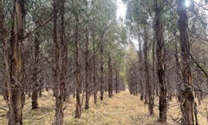
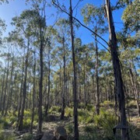
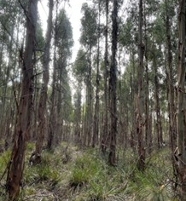
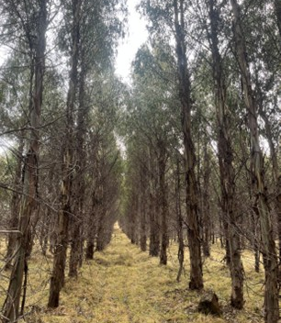
Schedule 4: Permanent Forest. No Silviculture for 25 years. Yields high numbers of ACCUs

Slide 9
Key Principles
Schedule 1 projects are eligible on land which has had no forest for at least 7 years.
Areas under the Plantation Methodology 2022 must store carbon for 25 years from the point of project registration. Commercial thinning or harvest and replanting may be factored into the regime.
ACCUs are calculated for the 25-year project life and usually issued in annual instalments over 15 - 20 years only.
Issuance of credits is not a tax event.
FullCAM is the CSIRO developed model which calculates the number of ACCUs to be issued.
The CER ACCU scheme accounts for management actions such as commercial thinning. The ACCUs issued are net, with commercial thinning not being considered an emission against the farm carbon budget.
Stand-alone projects need to be greater than 80 – 100 ha. Several smaller holdings may be aggregated to achieve the minimum project area.
AKS Forest Solutions provides a One-Stop-Shop for landowners wishing to register a project and access ACCUs.

